Slide 1
Principles of Marketing
Chapter#10
Pricing:
Understanding and Capturing Customer Value

Slide 2


Slide 3
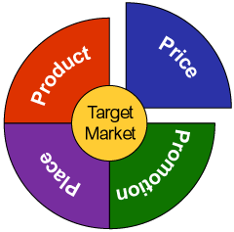
Today’s Topics

Slide 4
What is Price?
Price Has Many Names
Rent
Fee
Rate
Commission
Tuition
Fare
Toll
Premium
Bribe
Salary
Wage
Interest
Tax

Slide 5
Definition
Price
The amount of money charged for a product or service, or the sum of the values that consumers exchange for the benefits of having or using the product or service.
Price is the sum of all the values that consumers exchange for the benefits of having or using the product or service.
Price is the only element in the marketing mix that produces revenues; all others represent costs.

Slide 6
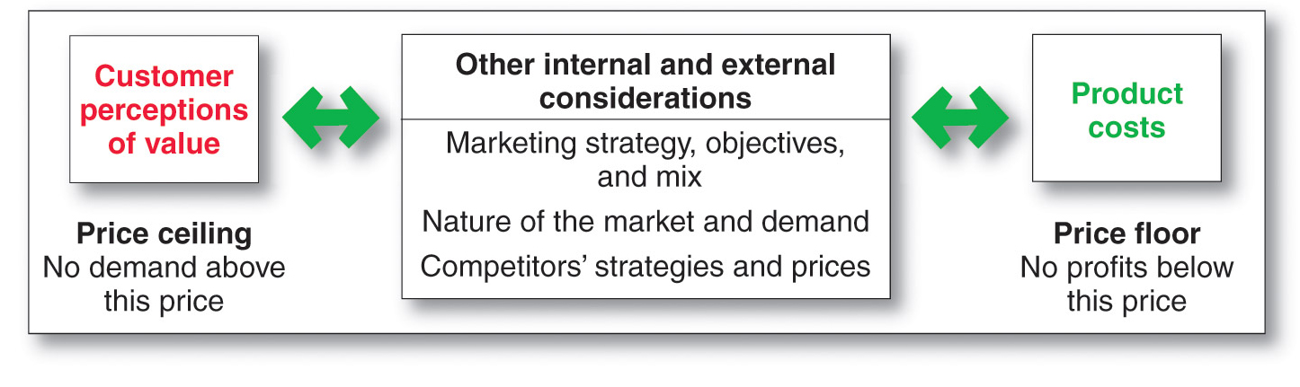
Factors Affecting Price Decisions

Slide 7
Customer Perceptions of Value
Understanding how much value consumers place on the benefits they receive from the product and setting a price that captures that value
Value-based pricing uses the buyers’ perceptions of value, not the sellers’ cost, as the key to pricing. Price is considered before the marketing program is set.
Value-based pricing is customer driven
Cost-based pricing is product driven

Slide 8
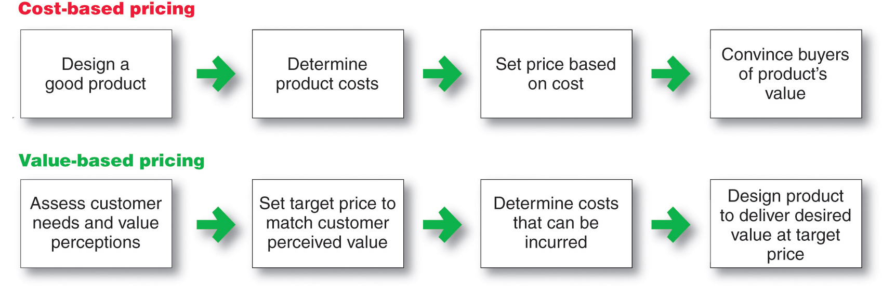
Cost-based pricing Vs. Value-based pricing

Slide 9
Value based pricing
Good-value pricing offers the right combination of quality and good service at a fair price
Existing brands are being redesigned to offer more quality for a given price or the same quality for a lower price
Everyday low pricing (EDLP) involves charging a constant everyday low price with few or no temporary price discounts
High-low pricing involves charging higher prices on an everyday basis but running frequent promotions to lower prices temporarily on selected items
Value-added pricing attaches value-added features and services to differentiate offers, support higher prices, and build pricing power
Pricing power is the ability to escape price competition and to justify higher prices and margins without losing market share

Slide 10
Cost-based pricing
Cost-based pricing involves setting prices based on the costs for producing, distributing, and selling the product plus a fair rate of return for its effort and risk
Cost-based pricing adds a standard markup to the cost of the product

Slide 11
Internal & External factors affecting pricing decisions

Slide 12


Slide 13
Internal Factors
Marketing Objectives
Marketing Mix Strategy
Costs
Organizational considerations
External Factors
Nature of the market and demand
Competition
Other environmental
factors (economy, resellers, government)
Pricing
Decisions

Slide 14
Marketing
Objectives
Marketing-Mix
Strategy
Internal Factors Affecting Pricing Decisions
Costs
Organizational
Considerations

Slide 15
Marketing Objectives that Affect Pricing Decisions

Slide 16
Survival
Low Prices to Cover Variable Costs and
Some Fixed Costs to Stay in Business.
Current Profit Maximization
Choose the Price that Produces the Maximum Current Profit, Cash Flow or ROI.
Marketing
Objectives
Market Share Leadership
Low as Possible Prices to Become
the Market Share Leader.
Product Quality Leadership
High Prices to Cover Higher
Performance Quality

Slide 17
Marketing Mix Variables that Affect Pricing Decisions

Slide 18
Product Design
and Quality
Marketing-Mix
Strategy
Non-Price
Factors
Distribution
Promotion

Slide 19
Costs
Set the floor for the price
Cover total costs - fixed plus variable costs
Fixed costs
do not vary with production volume
Variable costs
vary directly with production volume

Slide 20
Types of Cost Factors that Affect Pricing Decisions
Total Costs
Sum of the Fixed and Variable Costs for a Given
Level of Production
Fixed Costs
(Overhead)
Costs that don’t
vary with sales or
production levels.
Executive Salaries
Rent
Variable Costs
Costs that do vary
directly with the
level of production.
Raw materials
Notes:
Internal Factors Affecting Pricing Decisions
This CTR relates to the discussion on pp. 305-306.
Costs
Costs set the pricing floor that the company can charge for its product. Types of costs include:
Fixed Costs (or overhead) are costs that do not vary much with production or sales levels.
Variable Costs vary directly with the level of production.
Total Costs are the sum of the fixed and variable costs for any given level of production.

Slide 21
Fixed Costs
Variable Costs
Rent
Raw materials
Depreciation
Component parts
Manager’s salaries
Hourly wages
Property taxes
Packaging & freight
Insurance
Sales commissions

Slide 22
Break-Even Analysis and Target Profit Pricing
Break-even pricing is the price at which total costs are equal to total revenue and there is no profit
Target profit pricing is the price at which the firm will break even or make the profit it’s seeking
Fixed Cost
_________________
Price - Variable Cost
Break-even Volume =

Slide 23
Break-even Analysis & Target Profit Pricing

Slide 24
Market and
Demand
External factors affecting Pricing decisions
Competitors’ Costs,
Prices, and Offers
Other External Factors
Economic Conditions
Reseller Needs
Government Actions
Social Concerns

Slide 25
The Market and Demand factors that affect Pricing decisions
Pure Competition
Many Buyers and Sellers Who
Have Little Affect on the Price.
Monopolistic Competition
Many Buyers and Sellers Trading
Over a Range of Prices.
Different Types of Markets
Oligopolistic Competition
Few Sellers Each Sensitive to Other’s
Pricing/ Marketing Strategies
Pure Monopoly
Single Seller
Notes:
The Market and Demand
This CTR relates to the discussion on pp. 309-310.
The Market and Demand
Types of Markets. Each presents distinct pricing challenges:
Pure Competition - is characterized by many buyers and sellers to that no one agent affects pricing. Going rate pricing is the rule.
Monopolistic Competition - consists of many buyers and sellers trading over a range of prices. Products can be differentiated in quality, features, or styles.
Oligopolistic Competition - consists of few sellers each sensitive to the other's pricing and marketing strategies. Barriers to entry prohibit new sellers from entering the market.
Pure Monopoly. This market consists of a single seller. The seller may by a government, private regulated monopoly, or unregulated monopoly. Pricing may be linked to other than cost or profit factors, including fear of competition entering or regulation.
Consumer Perceptions of Price and Value. Buyers ultimately decide prices. Marketers must combine technical expertise with creative judgment and an awareness of buyers’ motivations.

Slide 26
Price-Demand Relationship
The demand curve shows the number of units the market will buy in a given period at different prices
Normally, demand and price are inversely related
Higher price = lower demand
For prestige (luxury) goods, higher price can equal higher demand when consumers perceive higher prices as higher quality

Slide 27
Price Elasticity of Demand
How quantity demanded responds to price changes
A. Inelastic Demand -
Demand Hardly Changes With
a Small Change in Price.
Price
P₂
P₁
Q₂
Q₁
Quantity Demanded per Period
B. Elastic Demand -
Demand Changes Greatly With a Small Change in Price.
Price
P’₂
P’₁
Q₂
Q₁
Quantity Demanded per Period

Slide 28
Elastic demand
price changes affect demand
total revenue falls when price increases
total revenue increases when price falls
Inelastic demand
price changes do not affect demand
total revenue increases when price increases
total revenue falls when price falls

Slide 29
Other environmental elements
Economic conditions
Affect production costs
Affect buyer perceptions of price and value
Reseller reactions to prices must be considered
Government may restrict or limit pricing options
Social considerations may be taken into account

Slide 30

All rights reserved. No part of this publication may be reproduced, stored in a retrieval system, or transmitted, in any form or by any means, electronic, mechanical, photocopying, recording, or otherwise, without the prior written permission of the publisher. Printed in the United States of America.
Copyright © 2010 Pearson Education, Inc.
Publishing as Prentice Hall

